Slide 1
Welcome
TUNGO SA
BAYANG MAGILIW - 4
Pamayanang Pakikilahok
sa Pamamahala
Notes:
[GREETING, INTRODUCE SELF AS FACILITATOR]

Slide 2
eFDS4 - Pamayanang Pakikilahok sa Pamamahala
Review of Social Accountability
Public Financial Management (PFM) Cycle
Barangay budgeting
Barangay development planning – Ang Plano ng Pamayanan
Workshop Outcome
Ang Plano ng Pamayanan (TPM 12)
Notes:
We will be covering these topics today and will practice barangay development planning.

Slide 3
UDHR Article 29
Everyone has duties to the community in which alone the free and full development of his personality is possible.
Ang bawat tao'y may mga tungkulin sa pamayanan sa ikaaari lamang ng malaya at ganap na pagkaunlad ng kanyang pagkatao.
Notes:
While we have rights, under UDHR Article 25, we also have duties to the community, expressed in UDHR Article 29. [READ & DISCUSS]

Slide 4
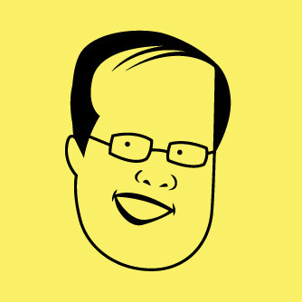
State of the Nation Address
President Benigno Aquino III
July 26, 2010
“Tungkulin po ng bawat Pilipino na tutukan ang mga pinunong tayo rin naman ang nagluklok sa puwesto. Humakbang mula sa pakikialam tungo sa pakikilahok. Dahil ang nakikialam, walang-hanggan ang reklamo. Ang nakikilahok, nakikibahagi sa solusyon.”
Source: http://www.google.com.ph
Mga Kalahok = Tagapagpadaloy ng Pagbabago
Notes:
[READ & DISCUSS] Ano ang pagkakaiba ng pakikialam sa pakikilahok?

Slide 5
Ang Pangarap ng Pamayanan
LGU ___________________________ as of (month/year)
Mapayapa at napapatupad ang batas
Nagmamahalan at nagtutulungang mamamayan
Maunlad
(DRAFT – REPLACE WITH OWN APPROPRIATE DATA FROM eFDS 2)
Maka-Diyos
Malinis at ligtas na kapaligiran
Nakikilahok at nagkakaisa na mamamayan
Notes:
This is the vision we worked on in the just past eFDS. All PL groups in [this LGU] selected the desirable attributes of a community. We consolidated all your selections and this is the vision for our whole LGU.
[Reinforce the vision and the attributes they selected for their community.]
You have said that these are the priority areas for development of our community.

Slide 6
The vision must be followed by the venture. It is not enough to stare up the steps - we must step up the stairs. ~Vance Havner
Ang pangarap ay dapat sundan ng pagkilos. Hindi sapat na titigan lamang ang hagdanan, kailangan humakbang paakyat.
Tagapagpadaloy ng Pagbabago
Notes:
We have defined our community vision. According to Vance Havner, a Baptist Preacher and author of many books on faith, [READ]
Are we just going to stare up the steps, or are we going to step up the stairs? This is all up to us. If we step up the stairs, we are on our way to becoming Facilitators of Change or Tagapagpadaloy ng Pagbabago.

Slide 7
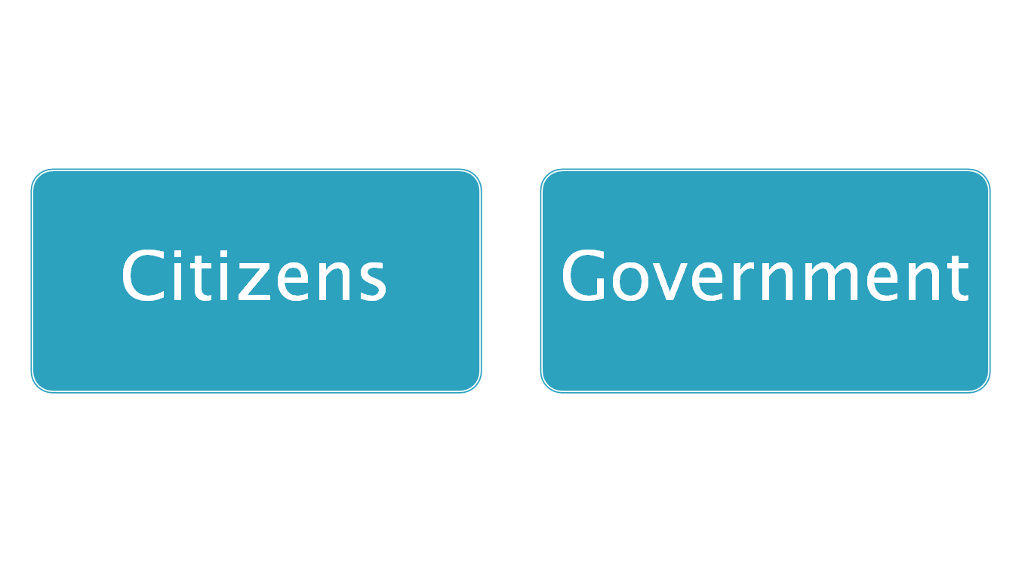
2 Key Players
Constructive Engagement (Makabuluhang Pakikilahok)
For better delivery of
Public service
Improvement of people’s welfare
Protection of people’s rights
= Social Accountability
(Pananagutang Panlipunan)
Notes:
There are 2 key players that have to work together (pagtutulungan) towards good governance – citizens and government working hand-in-hand. This working together is called constructive engagement (makabulunhang pakikilahok).
The goal of constructive engagement is better delivery of public service, improvement of people’s welfare and protection of people’s rights.
When citizens and government are truly working together, with real citizen participation, they are practising social accountability (pananagutang panlipunan).
7

Slide 8
Barangay Assembly
Consultations
Barangay Development Council
Financial Reporting
Project Monitoring
Public Service Monitoring
Planning
Budgeting
Expenditure
Monitoring
Pagmamanman
Pagplano
Public
Financial
Management
Cycle
Pananagutang Panlipunan
Para sa mas mahusay na paghahatid ng
- Palingkurang pangmadla
Pagpabuti ng kapakanang mamamayan
Pangangalaga ng karapatan pantao
Pagbadyet
Paggugol
Financial Reporting
Cost of Project
Project Allocation
Budget Hearing
IRA
Notes:
Our Social Accountability can be exercised throughout the Public Financial Management or PFM Cycle.
Public financial management begins with planning on what projects will be most helpful to the community. Citizens can participate in PFM planning through participation in the Barangay Assembly, other consultations, and through membership in the Barangay Development Council.
The next step in the PFM is budgeting. Citizens can participate through reviewing the project allocations, attending the budget hearings, reviewing where the IRA went.
After budgeting is expenditure, when funds are spent. Citizens can review the financial reporting, check on the cost of projects.
After expenditure is monitoring. Citizens can participate in project monitoring and review of financial reporting. After monitoring, we go back to planning. This is a yearly cycle.
Would you like to help government with their public financial management? Would you like to learn more about this? We will be teaching you how to budget and how to read financial reports. Would you like that?

Slide 9
Proceso ng Barangay Badyet
Schedule | Barangay Treasurer | Punong Barangay | Sangguniang Barangay | Sangguniang Bayan | Mamamayan
Pagpaplano
Jul - Aug
Pagbuo ng Barangay Development Council (BDC)
2 – 3 miembro ng BDC
Paghanda ng Badyet
Sept – Oct 15
Estimate ng kita at gastusin
Paghanda ng Badyet
Isumite ang Badyet sa Sangguniang Barangay
Pinagaralan at ipinasa ang badyet sa pamamagitan ng Ordinansa
Pagbibigay kapangyarihan sa Badyet
Oct 16 – Nov 15
Pagsusuri sa Badyet
Nov 16 – Dec 31
Isumite sa Municipal Budget Officer
Pag-aralan kung naayon sa batas ang Badyet
Paggastos sa Badyet
Jan 1 – Dec 31
Paggastos sa pera ayon sa LGC
Pagtanggap sa Badyet na naaprobahan
Bantayan ang kaban ng bayan , ang mga proyekto at paglilingkod ng opisyales
Pagsumite ng financial report
Pag-aralan at pirmahan ang financial report
Pananagutan sa Badyet
Jan 1 – Dec 31
Source: Local Government Code of 1991
Notes:
This is public financial management in the barangay and this happens yearly, beginning in July/August for the next year. For example, in July/August of 2015, the Punong Barangay should convene the Brgy Development Council (BDC) to prepare the Brgy Development Plan (BDP) for 2016. The BDC should include 2 – 3 members of the community.
In September, the Brgy Treasurer submits to the Punong Barangay the estimate of income and expenditure for the next year and the Punong Barangay allocates the income based on the BDP. By Oct. 16, the budget is presented to the Sangguniang Barangay for review and agreement. The Sangguniang Barangay then passes an Appropriation Ordinance.
By Nov. 16, the Appropriation Ordinance is submitted to the Municipal Budget Officer who reviews the allocations for compliance to laws and presents this to the Sangguniang Bayan for ratification.
The budget goes into effect on Jan 1 of the following year. The Barangay Treasurer can now spend funds based on the approved Appropriation Ordinance and submits a monthly financial report. By Jan. 30 of the next year, an annual financial report is prepared covering the entire year. The Punong Barangay reviews and signs the financial report which should now be posted in 3 conspicuous, public places.
Citizens can review the financial reports also, monitor projects and the performance of offficials. Let’s help our barangay officials make our barangay a good place to live and raise our families.

Slide 10
Ang pagpaplano ay paraan
ng pag-iisip at pag-aayos
ng mga gawain
para makamtan ang ninanais na layunin.
ANG PLANO NG PAMAYANAN
PANGARAP | LAYUNIN | SUKAT NG TAGUMPAY | GAWAIN NG MAMAMAYAN | TUGON NG PAMAHALAAN
Nakikilahok at nagkakaisang mamamayan | Magkaroon ng magaling at masipag na pamahalaan | Manalo ang magaling at masipag na candidato | Mamili ng magaling at masipag na punong barangay sa darating na halalan | Masipag na pamamahala
 | Bantayan ang kaban ng bayan | Lahat ng kalahok sa Pantawid ay dumalo sa Barangay Assembly at nagtanong sa proyekto ng brgy | Sumali sa Barangay Assembly at alamin ang pera ng barangay at saan ito ginastos | Tumawag ng Barangay Assembly at handang ihayag ang mga proyekto at budget
Notes:
Introduction to community development planning. [READ]
When we plan, we always start with our vision. Here is an example vision statement or pangarap. [READ VISION] If this is our vision, we then write down the objective. [READ LAYUNIN] We have to determine how we know we have achieved our objective or sukat ng tagumpay. [READ SUKAT NG TAGUMPAY] to achieve the sukat ng tagumpay, we have to determine what we citizens have to do and what we want the government to do. [READ EXAMPLES].
One vision statement can have several objectives or goals. [READ EXAMPLE 2]
We will now make our own Plano ng Pamayanan. What is our vision? [DIVIDE INTO SMALLER WORKING GROUPS. EACH GROUP TO PLAN FOR SPECIFIC VISION STATEMENTS, SHARE IN PLENARY.]

Slide 11
ANG PLANO NG PAMAYANAN (TPM 12)
Barangay: Parent Leaders: Date:
LGU:
PANGARAP | LAYUNIN | SUKAT NG TAGUMPAY | GAWAIN NG MAMAMAYAN | TUGON NG PAMAHALAAN
Notes:
We will now make our own Plano ng Pamayanan. What is our vision? [DIVIDE INTO WORKING GROUPS. EACH GROUP TO PLAN FOR 2 TO 3 VISION STATEMENTS, SHARE IN PLENARY.]

