Slide 1

Welcome
TUNGO SA
BAYANG MAGILIW - 3
Ating Karapatan sa Batas
at Pananagutang Panlipunan
Notes:
[GREETING, INTRODUCE SELF AS FACILITATOR]

Slide 2
eFDS3 – Ating Karapatan sa Batas at Pananagutang Panlipunan
Introduction to Social Accountability
Barangay governance and IRA
Tagapagpadaloy ng Pagbabago
ABC of participation in governance
Notes:
We will be covering these topics today.

Slide 3
Ang Pangarap ng Pamayanan
LGU ___________________________ as of (month/year)
Mapayapa at napapatupad ang batas
Nagmamahalan at nagtutulungang mamamayan
Maunlad
(DRAFT – REPLACE WITH OWN APPROPRIATE DATA FROM eFDS 2)
Maka-Diyos
Malinis at ligtas na kapaligiran
Nakikilahok at nagkakaisa na mamamayan
Notes:
This is the vision we worked on in the just past eFDS. All PL groups in [this LGU] selected the desirable attributes of a community. We consolidated all your selections and this is the vision for our whole LGU.
[Reinforce the vision and the attributes they selected for their community.]
You have said that these are the priority areas for development of our community.

Slide 4

UDHR Article 25
Everyone has the right to a standard of living adequate for the health and well-being of himself and of his family, including food, clothing, housing and medical care and necessary social services…
Ang bawat tao'y may karapatan sa isang pamantayan ng pamumuhay na sapat para sa kalusugan at kagalingan ng kanyang sarili at ng kanyang pamilya, kasama na ang pagkain, pananamit, paninirahan at pagpapagamot at kinakailangang mga paglilingkod panlipunan…
Notes:
The United Nations is an international organization founded in 1945 after the Second World War by 51 countries, including the Philippines, committed to maintaining international peace and security, developing friendly relations among nations and promoting social progress, better living standards and human rights. There are now 193 members of the United Nations.
The Universal Declaration of Human Rights (UDHR) is a declaration adopted by the United Nations General Assembly, including the Philippines, on 10 December 1948 in Paris. There are a total of 30 articles.
In his career in the United Nations, Rómulo was a strong advocate of human rights, freedom and decolonization. In 1948 in Paris, France, at the third UN General Assembly, he strongly disagreed with a proposal made by the Soviet delegation headed by Andrei Vishinsky, who challenged his credentials by insulting him with this quote: "You are just a little man from a little country." In return, Romulo replied, "It is the duty of the little Davids of this world to fling the pebbles of truth in the eyes of the blustering Goliaths and force them to behave!", leaving Vishinsky with nothing left to do but sit down.^{[3]}
UDHR Article 25 covers our rights to a standard of living … [READ and DISCUSS].

Slide 5
UDHR Article 29
Everyone has duties to the community in which alone the free and full development of his personality is possible.
Ang bawat tao'y may mga tungkulin sa pamayanan sa ikaaari lamang ng malaya at ganap na pagkaunlad ng kanyang pagkatao.
Notes:
While we have rights, under UDHR Article 25, we also have duties to the community, expressed in UDHR Article 29. [READ & DISCUSS]

Slide 6
Social Contract
Lipunan
Kasunduan
=
Kasunduang Panlipunan
FORMAL
INFORMAL
May kasulatan na
pinirmahan
Kultura
Kasanayan
Napag-usapan
Notes:
Lets talk about social contracts. Social = lipunan, contract = kasunduan. In Pilipino, a social contract is a kasunduang panlipunan.
A social contract can be formal or informal. A formal social contract is written and signed. What are some examples of a formal social contract? [Marriage contract, Resolutions, written Agreements, etc., gather examples from participants]
Informal social contracts may come from cultural practices or those verbally agreed upon. What are some examples of an informal social contract? [Wearing of clothes, Filipino time, showing respect (“po”), etc, gather examples from participants]
[In summary, ask the participants their understanding of social contract]

Slide 7

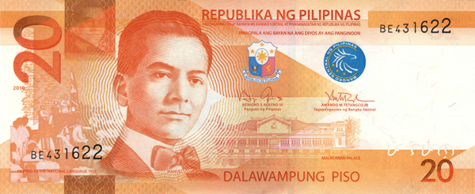
Anak, pabili nga ng asukal sa tindahan.
Notes:
For example, if you ask your child to buy sugar and give him P20, is this a social contract?

Slide 8
Social Contract
Kasunduang Panlipunan
Pag may kasunduan,
May pananagutan
Pananagutang Panlipunan
Social Accountability
Notes:
We have discussed the Social Contract, or Kasunduang Panlipunan. If there is a social contract or agreement, there is accountability, or social accountability or Pananagutang Panlipunan. Do you agree? How do we show this accountability?

Slide 9
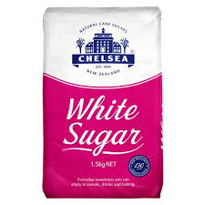
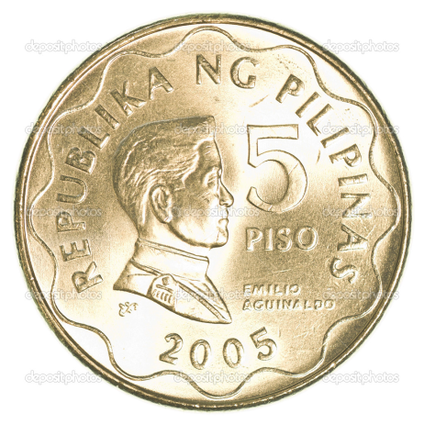



Notes:
For example, when you ask your child to buy some sugar from the sari-sari store, when the child agrees and receives the money from you, that is a kind of social contract. So you give your child P20 to buy sugar and tell him/her to give back the change. Your child goes to the store, buys P15 sugar and buys chips from the change of P5. Did the child fulfill the social contract? What did you say or do to the child?
In summary, what is Social Accountability? [GET DEFINITIONS FROM PARTICIPANTS]

Slide 10
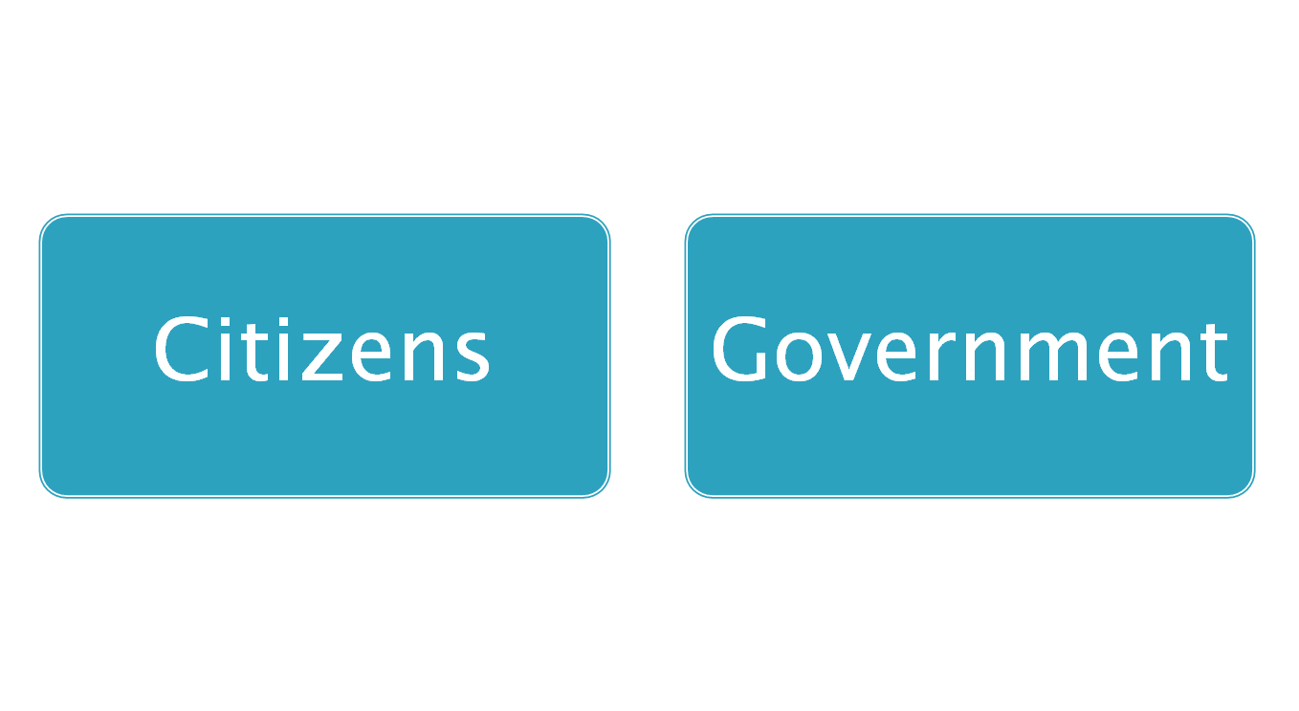
2 Key Players
Pananagutang Panlipunan
Social Accountability
Constructive Engagement (Makabuluhang Pakikilahok)
For better delivery of
Public service
Improvement of people’s welfare
Protection of people’s rights
Notes:
In the area of governance, there are 2 key players in the practice of Social Accountability. There are 2 key players that have to work together (pagtutulungan) towards good governance – citizens and government working hand-in-hand. This working together is called constructive engagement (makabulunhang pakikilahok).
The goal of constructive engagement is better delivery of public service, improvement of people’s welfare and protection of people’s rights.
When citizens and government are truly working together, with real citizen participation, they are practising social accountability (pananagutang panlipunan).
In governance then, when or how does Social Accountability happen? [GET ANSWERS/IDEAS FROM PARTICIPANTS]
In summary, Social Accountability happens when citizens and government work together for good governance, resulting in improved public service and people’s welfare and protection of people’s rights.
10

Slide 11


Planting the seeds of good governance
TRANSPARENCY
ACCOUNTABILITY
PARTICIPATION
UDHR Article 21
Everyone has the right to take part in the government of his country, directly or through freely chosen representatives.
Ang bawat tao'y may karapatang makilahok sa pamahalaan ng kanyang bansa, mismo o sa pamamagitan ng mga kinatawang malayang pinili.
COORDINATION
COLLABORATION
COOPERATION
COMMUNICATION
CITIZENS
GOVERNMENT
PAGTUTULUNGAN
Notes:
The right to take part in government is written in UDHR Article 21. [READ & DISCUSS] Who are our freely chosen representatives?
Our goal is good governance or maayos na pamamahala. The seeds of good governance are transparency (malinaw, naaaninagan), accountability (may pananagutan), participation (pakikilahok ng mamamayan). [DISCUSS EACH]
What is this picture? [GET RESPONSES FROM PARTICIPANTS]
It is a train. A train runs on 2 parallel tracks. One track represents citizens, the other track the government. Citizens and government have to work together (pagtutulungan) to allow the train to reach its destination. A train track has railroad ties that keep the 2 tracks parallel. Our railroad ties are the 4C’s -- coordination (koordinasyon), collaboration (pakikipagtulungan), cooperation (kooperasyon) and communication (pakikipag-usap).

Slide 12
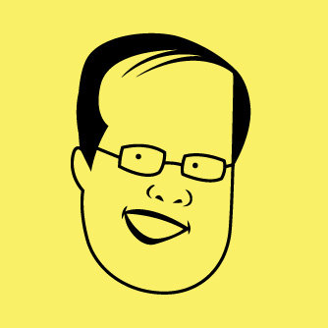
State of the Nation Address
President Benigno Aquino III
July 26, 2010
“Tungkulin po ng bawat Pilipino na tutukan ang mga pinunong tayo rin naman ang nagluklok sa puwesto. Humakbang mula sa pakikialam tungo sa pakikilahok. Dahil ang nakikialam, walang-hanggan ang reklamo. Ang nakikilahok, nakikibahagi sa solusyon.”
Source: http://www.google.com.ph
Notes:
[READ & DISCUSS] Ano ang pagkakaiba ng pakikialam sa pakikilahok?

Slide 13
What is a Barangay ?
Contiguous territory
Population
  Highly urbanized cities – at least 5,000 inhabitants
  Other areas – at least 2,000 inhabitants
Basic political unit
Primary planning and implementing unit of government policies, plans, programs, projects and activities in the community
People’s views may be expressed, crystallized and considered
Disputes amicably settled
(Magkadikit na kalupaan)
(Panguhahing tagapagplano at nagsasagawa ng proyecto sa
comunidad )
(Marinig ang boses ng mamamayan)
(Naaayos ang alitan)
Source: Local Government Code of 1991 (RA 7160)
Notes:
Local governance is regulated by the Local Government Code of 1991 or LGC, made into law as Republic Act (RA) 7160. In the LGC, the barangay is defined as follows. [READ AND ENSURE UNDERSTANDING]

Slide 14
Governmental Powers of the Barangay
Police power – health and safety, enhance prosperity, improve morals, maintain peace and order, preserve the comfort and convenience of the barangay inhabitants
Power of eminent domain – take private property for use of the public upon payment of just compensation to the owner
Power of taxation – Impose taxes, fees, and other charges on the barangay residents and businesses
      On stores or retailers whose gross sales is P30,000 or less (mun), P50,000 or less (city)
      Service fees or charges
      Barangay clearance
      Other fees
          Commercial breeding of fighting cocks, cockfights and cockpits
          Places of recreation which charge admission fees
          Billboards, signs, outdoor advertisements
(Magpabuwis)
Source: Local Government Code of 1991 (RA 7160)
Notes:
Based on the LGC, these are the governmental powers of the barangay. The first is police power. This doesn’t mean the Philippine National Police, but rather to watch and protect citizens in the given areas of health and safety, enhancing prosperity, etc. [READ & DISCUSS]
Highlight the power of taxation, sources of income to the barangay.

Slide 15
Sources of Income
50% of community tax collected through barangay treasurer
Real property tax – 25% to the barangay where the property is located
Quarry (sand, gravel) – 40% of proceeds collected by province
20% Internal Revenue Allotment (IRA) share
National wealth (ex. mining) - 35% of the 40% of the gross collection by national government
Source: Local Government Code of 1991 (RA 7160)
Notes:
Most barangays are very dependent on the IRA for income, but there may be other sources, such as…[READ & DISCUSS WHAT IS AVAILABLE IN THE VARIOUS BARANGAYS]
If the barangay has been allowed by the City/Municipal Treasurer to issue the Community Tax Certificate, 50% of the amount collected can be left in the barangay.
The LGU collects the real property tax or RPT. 25% of the amount collectd should go to the barangay where the property is located.
If there is a quarry in the barangay, the barangay will get 40% of any amount collected by the province.
The IRA is an allocation from the national government. All LGUs receive an allocation based on a formula. I will show you the IRA in the next slide.
If there is mining in the barangay, the barangay should receive 35% of the 40% gross collection by the national government.
So a barangay can have several sources of funds, most commonly from the IRA and the RPT.

Slide 16
IRA
2015
Mangaldan
by Barangay
Total
2015
Per
Month
Barangay Funds
Lahat ng kita ay pumapasok sa General Fund
Iniingatan ng city/municipal treasurer o naka-deposito sa malapit na banko ng gobyerno
Mangaldan LGU –
P146,586,989
Pangasinan Provincial Government –
P2,429,747,891
Pangasinan All City/Mun –
P 5,777,500,447
Pangasinan All Brgy –
P2,399,361,597
Total Pangasinan (Prov/City/Mun/ Brgy)
P10.6B
(DRAFT – REPLACE WITH OWN APPROPRIATE DATA)
Allocation --
55% Personnel maximum
20% Development Fund
10% SK
+
Senior citizens
Environment
Protection of children
Notes:
Replace with appropriate data for the LGU from www.dbm.gov.ph.
Each and every barangay has its own IRA. Give examples for the barangays of those present.
The city/municipality has its own IRA, give amount.
The province has its own IRA, give amount. Give total IRA (barangay, all LGUs, province) that went to the province (ex. Pangasinan = P10.6B in 2015).
Discuss barangay funds and mandatory allocations.

Slide 17
Barangay Budget
Fiscal Administration
An estimate of income and expenditure for the succeeding year is submitted by the barangay treasurer to the punong barangay on or before September 15
Punong barangay prepares budget and submits to the SB for legislative enactment
Reviewed by city/municipal SB through city/municipal budget officer within 60 days
Effective January 1 of succeeding year
All taxes, fees, charges are collected by barangay treasurer
  Official receipts issued
  Deposited within 5 days
Financial records kept in the office of the city/municipal accountant
Funds may only be used for the specific purpose listed in the budget
No advance payments allowed
Summary of income and expenditures of previous year posted in at least 3 publicly accessible and conspicuous places by January 31
Source: Local Government Code of 1991 (RA 7160)
Notes:
[READ & DISCUSS FOR UNDERSTANDING]

Slide 18
Powers and Duties of the Punong Barangay
Enforce laws
Sign contracts authorized by sangguniang barangay
Maintain public order
Call and preside over sangguniang barangay and barangay assembly meetings
Appoint or replace brgy secretary and treasurer, upon approval of SB
Organize and lead emergency group when needed
With BDC, prepare budgets
Approve vouchers
Administer katarungang pambarangay
Supervise the SK
Ensure the delivery of basic services – health, education, water
Conduct an annual palarong barangay
Promote the general welfare of the barangay
Punong barangay covers executive, legislative and judicial functions
Source: Local Government Code of 1991 (RA 7160)
Notes:
The Punong Barangay has so many powers and duties [READ & DISCUSS]
At the national level, we have the President for executive powers, the Congress for legislative powers and the Supreme Court for judicial powers. These different powers are divided at the national level. At the barangay level, the Punong Barangay has all 3 powers. He is the chief executive of the barangay, he leads the Sangguniang Barangay in the making of ordinances and resolutions, and he leads the Lupong Tagapamayapa.

Slide 19
Barangay Organization
Hindi nag-iisa magtrabaho ang punong barangay…
Sangguniang Barangay – Taga-gawa ng batas
Barangay Development Council (BDC) – Prepares and monitors barangay development plans
Lupong Tagapamayapa (LT) – Resolves minor disputes
Barangay Assembly (BA) – Reviews sangguniang barangay accomplishments, activities, finances and discusses barangay concerns
Sangguniang Kabataan (SK) – Issue resolutions on and addresses youth affairs, leads the KK
Katipunang Kabataan (KK) - Youth organization
Source: Local Government Code of 1991 (RA 7160)
Notes:
With all his powers and duties, the Punong Barangay doesn’t work alone. [READ & DISCUSS]

Slide 20
Barangay Development Council (BDC)
FUNCTIONS OF THE BDC
Mobilize people’s participation in local development efforts
Prepare barangay development plans that will most benefit its citizens
  Submitted to city/municipal sanggunian for integration into their plans
Monitor and evaluate the implementation of national or local programs and projects
Planning and coordinating body
Members
  Headed by Punong Barangay
  Sangguniang Barangay
  NGOs operating in the barangay, at least ¼ of the council (2 - 3 people)
  Representative of congressman
Meet at least once every 6 months or more often if needed (Barangay Executive Committee acts on its behalf in between)
Source: Local Government Code of 1991 (RA 7160)
Notes:
One of the bodies that helps the Punong Barangay is the Barangay Development Council. [READ & DISCUSS]

Slide 21
Barangay Assembly
Members
Resident for at least 6 months
Age 15 or older
Filipino
Registered in the list of barangay assembly members kept by the barangay secretary
Meetings
Called by
  Punong Barangay, or
  At least 4 members of the SB, or
  Written petition by min. 5% of the members of the Barangay Assembly
Meets at least 2x a year
Written notice one (1) week prior to meeting – posted publicly in conspicuous places
Agenda
Hear and pass upon the semestral report of the SB regarding
  Activities
  Finances
Discuss any barangay concerns
May propose, enact or amend ordinances
Source: Local Government Code of 1991 (RA 7160)
Notes:
Another important group to provide assistance to the Punong Barangay and the Sangguniang Barangay is the Barangay Assembly.
[READ & DISCUSS]
How to you think the Barangay Assembly is helpful? Do you attend the Barangay Assembly?

Slide 22
Qualifications of Brgy Officials
Filipino
At least 18 years old on election day
Registered voter of their barangay
Resident of at least one year
Able to read and write Filipino or any local language or dialect
Source: Local Government Code of 1991 (RA 7160)
Notes:
Based on the Local Government Code of 1991 or LGC, these are the qualifications of barangay officials. The official qualification is very simple and short, all of us here are probably qualified to run for election as a barangay official.

Slide 23
Anong hinahanap natin sa ating barangay officials?
Masipag
Hindi corrupt
Nakikinig sa problema
May puso
Maka-tao
Hindi nananakot
Madaling hanapin
Madaling kausapin
Tamad
Kurakot
Deadma
Manhid
Maka-sarili
Nakakatakot
Palaging wala
Mahirap kausapin
✓
✗
ano pa?
Notes:
[BEFORE SHOWING THE SLIDE] -- There should be other qualifications that we look for when we vote for our officials. Can you give some examples?
[SHOW THE SLIDE, DISCUSS]

Slide 24

The vision must be followed by the venture. It is not enough to stare up the steps - we must step up the stairs. ~Vance Havner
Ang pangarap ay dapat sundan ng pagkilos. Hindi sapat na titigan lamang ang hagdanan, kailangan humakbang paakyat.
Tagapagpadaloy ng Pagbabago
Notes:
We defined our community vision last month. According to Vance Havner, a Baptist Preacher and author of many books on faith, [READ]
Are we just going to stare up the steps, or are we going to step up the stairs? This is all up to us. If we step up the stairs, we are on our way to becoming Facilitators of Change or Tagapagpadaloy ng Pagbabago.

Slide 25
Get Acquainted with barangay gov’t
Know/meet your barangay officials
Visit the barangay hall, facilities, workers
Check bulletin boards, note bulletins
Barangay Assembly Agenda
Volunteerism and Active Citizenship
Introduction of officials present
Punong Barangay report
  Activities/accomplishments since the last Barangay Assembly
  Finances (income & expenditure to-date vs. investment plan)
  Upcoming programs and plans
Discussion of barangay concerns and possible solutions, agree on priorities (with open forum)
Any proposals to enact or amend ordinances
Conduct training, share the ABC’s
Volunteer to help the punong barangay and sangguniang barangay
Seek and develop others who wish to serve
Notes:
When we first went to school, we were first taught our ABCs. We are now in school again, the school of social accountability (pananagutang panlipunan). Our ABCs are the following – [READ & DISCUSS]. Do you think we can follow the ABCs? Gather commitment to perform the ABCs.

