Slide 1
Welcome
TUNGO SA
BAYANG MAGILIW - 8
“The first wealth is health.”
Ralph Waldo Emerson
(May 25, 1803 – April 27, 1882) American essayist, lecturer, and poet
Ang Pangunahing Kayamanan ay Kalusugan
Notes:
[GREETING, INTRODUCE SELF AS FACILITATOR] Our topic today has to do with health. As Ralph Waldo Emerson has said, “The first wealth is health”.

Slide 2
eFDS8 – Ang Pangunahing Kayamanan ay Kalusugan
Health rights Mga karapatan sa kalusugan
Responsibilities of Pantawid members Mga tungkulin ng miyembro ng Pantawid
Why have a health check-up? Bakit kailangan magpa-checkup?
BHS Equipment Checklist
Community Scorecard (CSC)
Notes:
These are the topics we will cover today.

Slide 3
UDHR Article 25
Everyone has the right to a standard of living adequate for the health and well-being of himself and of his family, including food, clothing, housing and medical care and necessary social services…
Ang bawat tao'y may karapatan sa isang pamantayan ng pamumuhay na sapat para sa kalusugan at kagalingan ng kanyang sarili at ng kanyang pamilya, kasama na ang pagkain, pananamit, paninirahan at pagpapagamot at kinakailangang mga paglilingkod panlipunan…
Notes:
The United Nations is an international organization founded in 1945 after the Second World War by 51 countries, including the Philippines, committed to maintaining international peace and security, developing friendly relations among nations and promoting social progress, better living standards and human rights. There are now 193 members of the United Nations.
The Universal Declaration of Human Rights (UDHR) is a declaration adopted by the United Nations General Assembly, including the Philippines, on 10 December 1948 in Paris. There are a total of 30 articles.
In his career in the United Nations, Rómulo was a strong advocate of human rights, freedom and decolonization. In 1948 in Paris, France, at the third UN General Assembly, he strongly disagreed with a proposal made by the Soviet delegation headed by Andrei Vishinsky, who challenged his credentials by insulting him with this quote: "You are just a little man from a little country." In return, Romulo replied, "It is the duty of the little Davids of this world to fling the pebbles of truth in the eyes of the blustering Goliaths and force them to behave!", leaving Vishinsky with nothing left to do but sit down.^{[3]}
UDHR Article 25 covers our rights to a standard of living … [READ and DISCUSS].

Slide 4
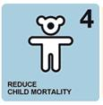
UNIVERSAL HEALTH CARE - KALUSUGAN PANGKALAHATAN (KP)
Para sa lahat na mamamayan
Pagpapatupad ng Social Contract ni Presidente Aquino sa mamamayan tungkol sa kalusugan
2.1. GOALS/Layunin
Strengthen PhilHealth Patibayin ang PhilHealth
Improve the quality of hospitals and health care facilities Pabutihin ang kalidad ng ospital at ibang pasilidad pangkalusugan
Achieve Millennium Development Goals (MDGs)
Lahat ng miyembro ng Pantawid ay miyembro ng PhilHealth
Bawasan ang namamatay na bata
Pagbutihin ang kalusugan ng nanay
Notes:
In response to UDHR 25, our government has the Universal Health Care program.
The goals of Universal Health Care are…[READ & DISCUSS]
The MDGs are also additional goals that the United Nations has asked their member countries to focus on. 2 goals that the Pantawid Program contributes to are MDG4 – Reduce child mortality and MDG5 – Improve maternal health.
All members of the Pantawid Program are automatically members of PhilHealth.

Slide 5
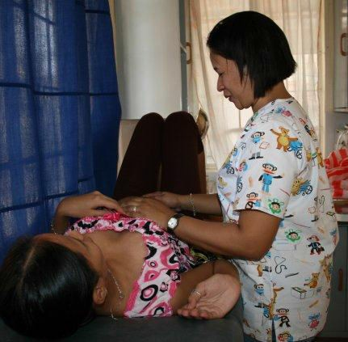
Mga Kondisyon upang makamit ang BENEPISYO
Pumunta sa lokal na health center para sa check-up bago at pagkatapos manganak
Magkaroon ng kahit isang check-up anim na linggo pagkatapos manganak
5
Notes:
The beneficiaries should be familiar with their co-responsibilities. First ask the group what their co-responsibilities are before showing the slide.

Slide 6
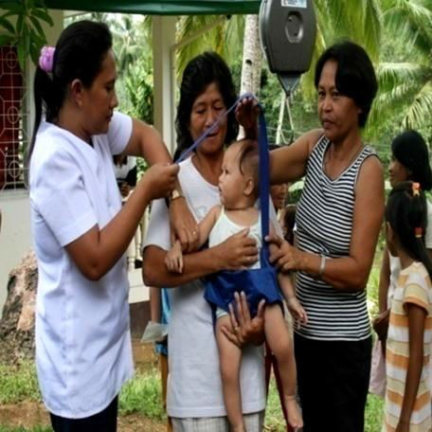
Mga Kondisyon upang makamit ang BENEPISYO
Children 0-5 Years Old
Visit the health center to avail immunization Pagbabakuna
Have monthly weight monitoring and nutrition counseling for children aged 0 - 2 years old Magtimbang minsan kada buwan
Have bi-monthly weight monitoring for 2 – 5 years old Magtimbang minsan kada 2 buwan
Have management of childhood diseases for sick children Mabigyang lunas ang batang may sakit
Children 6-18 Years Old
Must receive deworming pills twice a year (through school) Magpurga sa paaralan
Notes:
The beneficiaries should be familiar with their co-responsibilities. First ask the group what their co-responsibilities are before showing the slide.

Slide 7
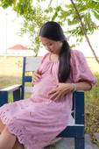
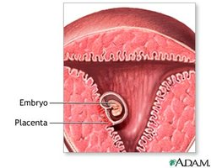
Pregnant Household Member
Pre-natal Check-up
Every 4 weeks until 28 weeks of pregnancy
Every 2 weeks until 36 weeks of pregnancy
Every week until 41 weeks
Every few days until you give birth
Post-natal Check-up
24 hours after delivery
1 month after delivery, home visit
Tetanus Toxoid for Mothers
Notes:
These are the health care standards for a pregnant Pantawid member. [READ & DISCUSS]
Point out to the participants that they need 5 shots of Tetanus Toxoid to be immune for life. A sample schedule is given in the slide.

Slide 8
Para manatiling malusog si baby
The World Health Organization (WHO) recommends exclusive breastfeeding for the first six months of life, after which "infants should receive nutritionally adequate and safe complementary foods while breastfeeding continues up to two years of age or beyond.“
Benefits – Higher immunity from infection, better mental health, lower risk of asthma, etc.
Notes:
This slide contains the immunization schedule of a baby. Outline the illnesses avoided as a result of immunization. Discuss whether the mothers in the group appreciate immunization. They may not realize that the government spends over P13,000 per child to provide this service.
Another area to emphasize is the benefits of breastfeeding.

Slide 9
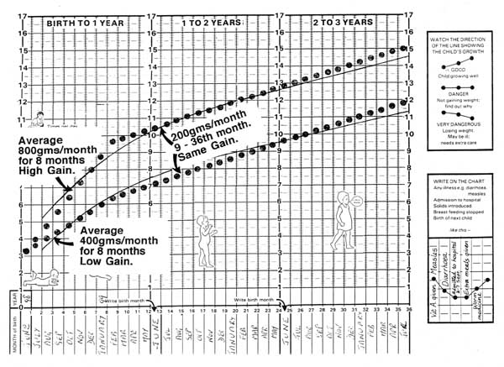
Ang hustong paglaki ng bata
Notes:
This is an example of your child’s growth chart. Does your BHS or RHU monitor your child’s growth? Using this chart, you can find out if your child is gaining weight and height normally. From birth to 8 months, your child should gain from 400-800 grams per month. From 9 – 36 months, your child should gain 200 grams per month.

Slide 10
PRIMARY CARE PACKAGE
Primary Preventive Services
Consultation
Visual Inspection with Acetic Acid
Regular BP measurements
Breastfeeding program education
Periodic Clinical Breast Examination
Counseling for lifestyle modification
Counseling for smoking cessation
Body measurements
Digital Rectal Examination
Diagnostic Examination
Complete Blood Count
Urinalysis
Fecalysis
Sputum microscopy
Fasting blood sugar
Lipid profile
Chest Xray
Drugs and Medicines for the following conditions 1. Asthma including nebulization services 2. Acute Gastroenteritis (AGE) with no or mild dehydration 3. Upper Respiratory Tract Infection URTI/Pneumonia mild and low risk 4. Urinary Tract Infection
Notes:
This is the Primary Health Care package that may be found in the RHU. [Discuss which services they know of are available.]

Slide 11
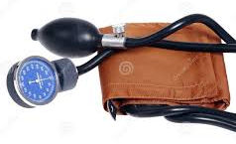
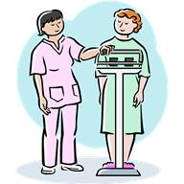
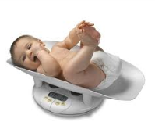
BHS Equipment Checklist
City/Mun | Brgy | Group
Parent Leader(s) |  | Date/Time
Checklist (To be physically checked by the PL in BHS prior to eFDS cascading, one checkmark per row)
Equipment | Mayroon at umaandar | Mayroon ngunit hindi umaandar | Wala | Remarks
Sphygmomanometer (For blood pressure)
Weighing scale for adults
Weighing scale for infants
Height measuring Equipment (fixed on stick or wall)
Notes:
One of the main requirements for a good check-up at the BHS is the availability of equipment. There is an assignment for you Parent Leaders to do outside this workshop. We need one report per barangay, so all PLs of a barangay will work together to complete this report. It has to be done before the eFDS cascade to your members. The report will be submitted to the eFDS Observer.
[DESCRIBE EQUIPMENT TO BE CHECKED AND HOW TO FILL UP FORM]

Slide 12
Community Scorecard (CSC)
A participatory, community-based monitoring and evaluation tool Pamamaraan para makilahok sa pamamahala at pagsusuri
That enables citizens to assess the quality of public services such as a health center, school, public transport, water, waste disposal systems, etc., seeking areas for improvement Pagsusuri ng kalidad ng serbisyo publiko kagaya ng para sa kalusugan, edukasyon, transportasyon, patubig, atbp. para mapabuti o mapaganda ito
Notes:
[READ & ENSURE UNDERSTANDING]

Slide 13
Proseso ng Community Scorecard (CSC)
The CSC informs community members about Paguusapan ang
available services in the community serbisyo publiko
their entitlements to these services karapatan natin ukol sa serbisyo publiko
The CSC asks for users’ direct feedback about the quality, efficiency, and accessibility of these services Nagtatanong tungkol sa kalidad, husay at pagkarating ng serbisyo publiko, sa pagbibigay ng “score”
Notes:
[READ & ENSURE UNDERSTANDING]

Slide 14
Proseso ng Community Scorecard (CSC)
Those providing the public service also rate their performance Ang tagapamahala sa serbisyo publiko ay nagbibigay alam din tungkol sa kalidad, husay at pagkarating ng kanilang serbisyo publiko
The service providers and their clients sit down and discuss the scorecard results and how to improve these Ang tagapamahala sa serbisyo publiko at ang tumatanggap ng serbisyo ay nakikipag-ugnayan tungkol sa resulta at paano mapaganda pa ang serbisyo publiko
---Interface Meeting---
Notes:
[READ & ENSURE UNDERSTANDING]
4. The meeting to discuss the scorecard results and how to improve these is called an Interface Meeting.

Slide 15
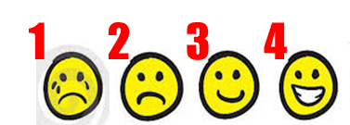
Health Services Community Scorecard
We will review the health services provided by our LGU on specific attributes Susuriin natin ang tungkol sa serbisyo kalusugan ng ating bayan
For each attribute, we will assign a score Magbibigay tugon sa bawat katangian
Indicate reasons for the rating Maglagay ng detalya kung bakit ganun ang ibinigay na puntos at mga mungkahi para mapabuti ang puntos
Gagawin ito para sa Rural Health Unit (RHU) at Barangay Health Station (BHS)
Notes:
[READ & ENSURE UNDERSTANDING] [YOU MAY WANT TO PRINT THE SMILEYS AND DISTRIBUTE AMONG THE PARTICIPANTS, FOR THEIR REFERENCE DURING THE FOLLOWING SCORING PROCESS]

Slide 16
Notes:
[Distribute the scorecard for the RHU to each participant. Describe each indicator, ask the participants to score the indicator as a group and provide reasons for the rating and/or suggestions for improvement.
Model the scoring process the PLs will follow with their beneficiary groups to arrive at one CSC form each for RHU and BHS per beneficiary group
Instruct the PLs to arrive at one score for each of their groups]

Slide 17
Notes:
[Distribute the scorecard for the BHS to each participant. Describe each indicator, ask the participants to score the indicator as a group and provide reasons for the rating and/or suggestions for improvement.
Model the scoring process the PLs will follow with their beneficiary groups to arrive at one CSC form each for RHU and BHS per beneficiary group
Instruct the PLs to arrive at one score for each of their groups
Inform the PLs that the next meeting is an Interface Meeting, so they will all be in one group. All PLs of the LGU will attend a single session, together with the service provider. Provide date, time and venue.]

Slide 18
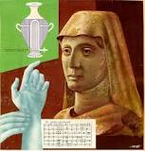
“When health is absent,
wisdom cannot reveal itself,
art cannot manifest,
strength cannot fight,
wealth becomes useless,
and intelligence cannot be applied.” ― Herophilus (335-280 BC)
Pag walang kalusugan,
ang karunungan ay hindi maipapakita,
ang sining ay hindi maihahayag,
ang kalakasan ay hindi mailalaban,
ang kayamanan ay walang kabuluhan
at ang katalinuhan ay hindi magagamit.
Notes:
READ & DISCUSS

Slide 19
BHS Equipment Checklist (BM7)
City/Mun | Brgy | Group
Parent Leader(s) |  | Date/Time
Checklist (To be physically checked by the PL in BHS prior to eFDS cascading, one checkmark (✓) per row)
Equipment | Mayroon at umaandar | Mayroon ngunit hindi umaandar | Wala | Remarks
Sphygmomanometer (For blood pressure)
Weighing scale for adults
Weighing scale for infants
Height measuring Equipment (fixed on stick or wall)
Notes:
One of the main requirements for a good check-up at the BHS is the availability of equipment. There is an assignment for you Parent Leaders to do outside this workshop. We need one report per barangay, so all PLs of a barangay will work together to complete this report. It has to be done before the eFDS cascade to your members. The report will be submitted to the eFDS Observer.
[DESCRIBE EQUIPMENT TO BE CHECKED AND HOW TO FILL UP FORM]

