Slide 1
Welcome
TUNGO SA
BAYANG MAGILIW - 6
Ang Paglagda ng
Kasunduang Panlipunan
Notes:
[SLIDES IN THIS PRESENTATION MAY BE SHARED WITH THE AUDIENCE OF THE SOCIAL CONTRACT SIGNING EVENT]
[GREET AND WELCOME PARTICIPANTS, INTRODUCE SELF AS EMCEE]

Slide 2
Social Contract Signing – Program (venue, date, time)
Opening Prayer
Acknowledgment of Participants
A brief introduction of the Pantawid Program, our civil society organization (LCSO) and the i-Pantawid Project
The Social Contract Proper
Social Contract content
Sharing the community vision
Sharing the community development priorities
Response from the Municipal Officials
Signing of the Social Contract
Closing Prayers/Blessing
Picture Taking
Emcee : (name)
Notes:
This is our program for today. Let’s start with an opening prayer, to be led by _________.
Let’s acknowledge those present here today ….
For our special guests from the LGU, we have prepared a brief introduction of the Pantawid Program (as needed), our civil society organization __________, and the i-Pantawid Project (see separate sample slides)
Going back to our program today, we will now discuss the content of the Social Contract.

Slide 3
Insert Introductory Slides (see sample)

Slide 4
Ang Pangarap na Pamayanan
LGU ___________________________ as of (month/year)
Mapayapa at napapatupad ang batas
Nagmamahalan at nagtutulungang mamamayan
Maunlad
(EXAMPLE ONLY – REPLACE WITH OWN APPROPRIATE DATA FROM eFDS 2)
Maka-Diyos
Malinis at ligtas na kapaligiran
Nakikilahok at nagkakaisa na mamamayan
Notes:
This is the vision for our community that the Pantawid members, through their Parent Leaders, defined.
Let’s now hear from some Parent Leaders what these aspirations mean to them.

Slide 5
ANG PLANO NG AMING PAMAYANAN
LGU/Barangay: Parent Leaders: Date:
PANGARAP | LAYUNIN | SUKAT NG TAGUMPAY | GAWAIN NG MAMAMAYAN | TUGON NG PAMAHALAAN
Nakikilahok at nagkakaisang mamamayan | Magkaroon ng magaling at masipag na pamahalaan | Manalo ang magaling at masipag na candidato | Mamili ng magaling at masipag na punong barangay sa darating na halalan | Masipag na pamamahala
 | Bantayan ang kaban ng bayan | Lahat ng kalahok sa Pantawid ay dumalo sa Barangay Assembly at nagtanong sa proyekto ng brgy | Sumali sa Barangay Assembly at alamin ang pera ng barangay at saan ito ginastos | Tumawag ng Barangay Assembly at handang ihayag ang mga proyekto at budget
(EXAMPLE ONLY – REPLACE WITH OWN APPROPRIATE DATA FROM eFDS 4)
Notes:
The Pantawid members also developed some plans to improve our community. Let’s now hear from some Parent Leaders what these development priorities are, what they plan to do to achieve these priorities, and what they would like to request from their LGU officials.

Slide 6
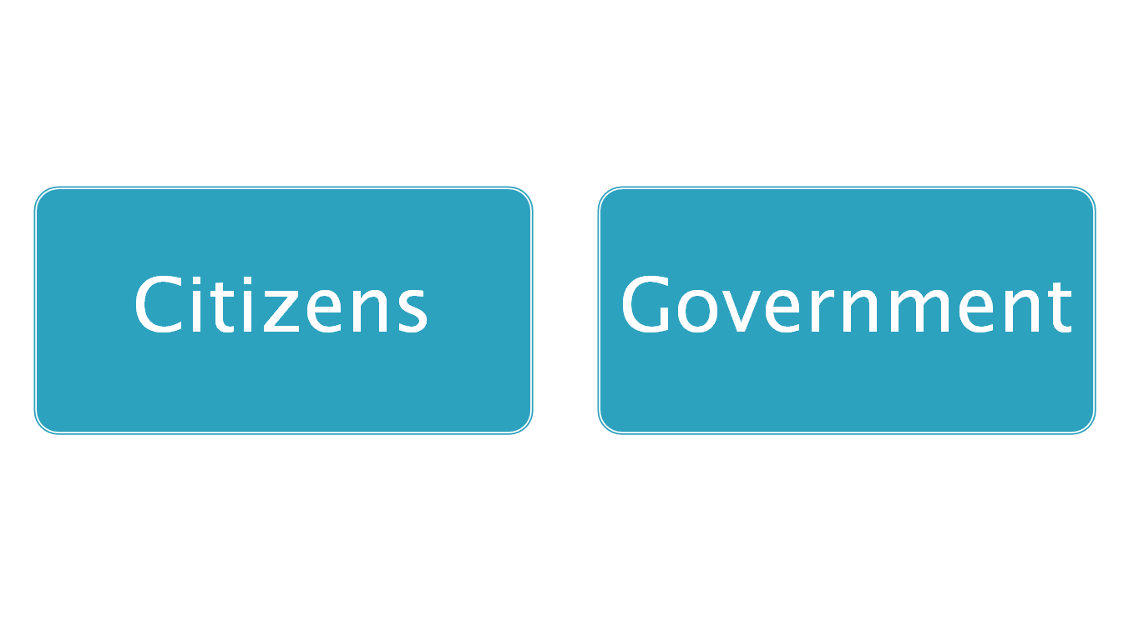
2 Key Players
ANG INAASAHANG TUGON NG LOCAL NA PAMAHALAAN
Constructive Engagement (Makabuluhang Pakikilahok)
Para sa mas mahusay na paghahatid ng
- Palingkurang pangmadla
Pagpabuti ng kapakanang mamamayan
Pangangalaga ng karapatan pantao
Notes:
What we are saying is that as part of our duties to the community, we are willing to help the government do a good job for us. What is this good job we want? Para sa mas mahusay na paghahatid ng - Palingkurang pangmadla, Pagpabuti ng kapakanang mamamayan, Pangangalaga ng karapatan pantao
Working together with government is called “Constructive Engagement”.
We would like to establish this working relationship of constructive engagement through this Social Contract.
6

Slide 7
SOCIAL CONTRACT KASUNDUANG PANLIPUNAN This Social Contract is entered into by duly authorized representatives of the Local Government Unit of _________________________________________________________, (city/municipality, province) represented by officials present, referred to as LGU officials and Pantawid Pamilyang Pilipino Program members of ____________________________________, (city/municipality, province) represented by their Parent Leaders and members present, referred to as Pantawid members.
Document title (Social Contract)
Parties to the Social Contract
Preamble (Batayan ng kasunduan)
Pangarap ng Pamayanan
Ang Plano ng Aming Pamayanan
Tugon ng pamahalaan (LGU officials)
Tugon ng mamamayan (Pantawid members)
Kailan ginawa ang kasunduan
Lagda ng mga kalahok
Notes:
[REVIEW OF SOCIAL CONTRACT CONTENT]
We would now like to hear from the LGU on their response to the Social Contract. [SELECTED OFFICIALS TO SPEAK]
Are we ready to sign this document?

Slide 8
Coming together is a beginning
Keeping together is progress
Working together is success
Henry Ford
Ang pagsamasama ay pasimula
Ang manatiling magkasama ay pagsulong
Ang magsama sa gawain ay tagumpay
Notes:
A final word …

