Slide 1
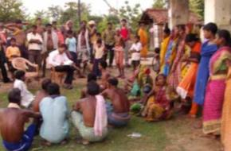
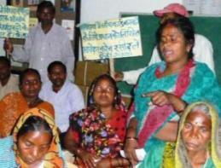
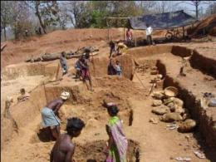
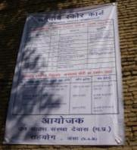
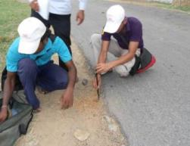
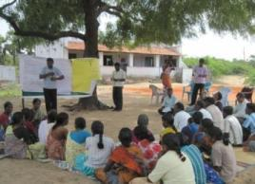
Social Accountability & Improved Public Performance
Learning from ANSA’s Experience in South Asia
Naimur Rahman
Chief Operating Officer
ANSA-South Asia Region

Slide 2
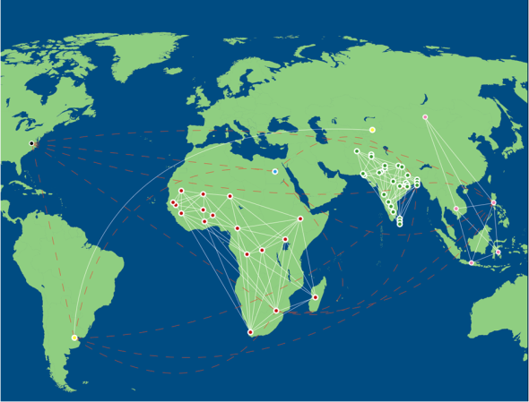
Affiliated Network for Social Accountability (ANSA)
ANSA aims to create networked synergies among actors and institutions engaged in social accountability and demand-side governance
To incubate, promote & sustain new ideas and approaches
To connect practitioners and researchers for knowledge co-creation and peer-learning
Towards accomplishing this mandate, ANSA - South Asia Region (ANSA-SAR) supported Social Accountability innovations through small grants in India, Nepal, Bangladesh, Sri Lanka and Pakistan to pilot & experiment diverge approaches of citizens’ demanding good governance
Experiential learning from these processes and praxis were analyzed and documented to deepen knowledge on social accountability in South Asian context.

Slide 3
Social Accountability Experiments of ANSA in India
Madhya Pradesh
People’s Initiative for Accountability and Transparency in Health and Education
Orissa
Promoting Social Accountability to Assert the Right to Food & Livelihood of the Poor
Enabling Community Monitoring of Rural Roads under PMGSY
Social Watch Group for Social Accountability and Governance
Accountability and livelihood security of poor and marginalized of Orissa.
Rajasthan
Monitor the Public Expenditure Outcomes in MGNREGS
Audit the Right to Education
Tamil Nadu
Enhancing Community Centered Governance in Climate Change Affected Coastal Areas
Empowering marginalized communities to negotiate their rights & entitlements through RTI
Uttar Pradesh
Empowering rural people for seeking their entitlements under MNREGA to ensure livelihood and food security
Multiple States
Reports from the Other India - Social Accountability through Media Oversight at Grassroots

Slide 4
…. and in other South Asian Countries
Community Score Card in Primary Education and Social Safety-net Project – Bangladesh
Role of Governance against Climate Change Induced Migration – Bangladesh
Mobile based Citizens’ Feedback on public service delivery and social sector programmes – Bangladesh
People and the Land: Empowering Communities for Social Justice in Rural Karachi – Pakistan
Equitable Education in Pakistan: Addressing Gender and Rural-Urban gaps in Lower Secondary Education – Pakistan
Transparent and Accountable Public Procurement in Local Authorities – Sri Lanka
Making Representative Accountable – Nepal

Slide 5
Key Lessons, Issues & Emerging Challenges - I
Social Accountability processes tend to be complex, nonlinear, and embedded in broader political and societal context
Inequality and exclusion need to be central within accountability agenda
The "tools-based" approach risks obscuring the underlying social and political processes that really explain why a given tool is, or is not effective
Social Accountability processes appear to be more likely to bring about change when they support existing pressures for change together with a number of enabling factors:
deepening of democracy, appropriate legal frameworks,
enhanced ability of citizens for informed engagement with state actors, and
proliferation of new technologies especially mobile phones
The use of high-quality and relevant information happens to be a key ingredient for accountability change; however information alone is not sufficient – pro accountability collective action is often needed.

Slide 6
Key Lessons, Issues & Emerging Challenges - II
Need for scaling social accountability endeavors to demonstrate tangible outcome with regard to governance responsiveness especially in countries like India; but there are major challenges:
How to transplant one successful model from one context to another
How to embed social accountability praxis across the hierarchy of public institution or government
Calls for considerable Knowledge & Research investments to create adaptable paradigms for taking successful social accountability initiatives to scale
To methodically look at the scope and challenges of harmonizing social accountability processes across large and diverge contextual scenarios; and potentially across the decision hierarchy of public institutions and the government
Need for co-creating research framework for rigorous and evidence based mapping of social accountability results influencing attributable impact with regard to development effectiveness and outcome.

